Slide 1
ClimeHop
Lecture slides

Slide 2
Conservation measures for the large marsh grasshopper
Measure name | Measure definition | Number of mowing events | Ecological impact | Costs
Very early mowing | Mowing until 7 weeks after the beginning of the vegetation period | 1 | ++ | €€
Early mowing | Mowing until 9 weeks after the beginning of the vegetation period | 1 | +++ | €€€
Late mowing | Mowing after 21 weeks after the beginning of the vegetation period | 1 | ++++ | €€€€
Very late mowing | Mowing after 23 weeks after the beginning of the vegetation period | 1 | +++++ | €€€€€
Mowing twice | Mowing until 7 and after 23 weeks after the beginning of the vegetation period | 2 | + | €

Slide 3
Cost-effectiveness
Imagine a landscape divided into 9 grid cells

Slide 4
Cost-effectiveness
Imagine a landscape divided into 9 grid cells
Each grid cell has a specific „ecological value“ (EV)
9 EV | 8 EV | 7 EV
6 EV | 5 EV | 4 EV
3 EV | 2 EV | 1 EV

Slide 5
Cost-effectiveness
Imagine a landscape divided into 9 grid cells
Each grid cell has a specific „ecological value“ (EV)
Each grid cell also has specific conservation costs
9 EV 6,000€ | 8 EV 4,000€ | 7 EV 4,000€
6 EV 4,000€ | 5 EV 2,500€ | 4 EV 2,000€
3 EV 2,000€ | 2 EV 1,000€ | 1 EV 1,000€

Slide 6
Cost-effectiveness
Each grid cell has a specific „ecological value“ (EV) and conservation costs
In which order would an ecologist who only considers ecol. value choose conservation sites?
9 EV 6,000€ | 8 EV 4,000€ | 7 EV 4,000€
6 EV 4,000€ | 5 EV 2,500€ | 4 EV 2,000€
3 EV 2,000€ | 2 EV 1,000€ | 1 EV 1,000€

Slide 7
Cost-effectiveness
Each grid cell has a specific „ecological value“ (EV) and conservation costs
In which order would an ecologist who only considers ecol. value choose conservation sites?
Start with 9EV, then 8EV, then 7EV etc.
9 EV 6,000€ | 8 EV 4,000€ | 7 EV 4,000€
6 EV 4,000€ | 5 EV 2,500€ | 4 EV 2,000€
3 EV 2,000€ | 2 EV 1,000€ | 1 EV 1,000€

Slide 8
Cost-effectiveness
Each grid cell has a specific „ecological value“ (EV) and conservation costs
In which order would an ecologist who only considers ecol. value choose conservation sites?
Start with 9EV, then 8EV, then 7EV etc.
In which order would an economist who only considers costs choose conservation sites?
9 EV 6,000€ | 8 EV 4,000€ | 7 EV 4,000€
6 EV 4,000€ | 5 EV 2,500€ | 4 EV 2,000€
3 EV 2,000€ | 2 EV 1,000€ | 1 EV 1,000€

Slide 9
Cost-effectiveness
Each grid cell has a specific „ecological value“ (EV) and conservation costs
In which order would an ecologist who only considers ecol. value choose conservation sites?
Start with 9EV, then 8EV, then 7EV etc.
In which order would an economist who only considers costs choose conservation sites?
Start with cheapest (1,000€), then 2,000€ etc.
9 EV 6,000€ | 8 EV 4,000€ | 7 EV 4,000€
6 EV 4,000€ | 5 EV 2,500€ | 4 EV 2,000€
3 EV 2,000€ | 2 EV 1,000€ | 1 EV 1,000€

Slide 10
Cost-effectiveness
Each grid cell has a specific „ecological value“ (EV) and conservation costs
Budget constraint: 6,000€
Which sites would they choose?
9 EV 6,000€ | 8 EV 4,000€ | 7 EV 4,000€
6 EV 4,000€ | 5 EV 2,500€ | 4 EV 2,000€
3 EV 2,000€ | 2 EV 1,000€ | 1 EV 1,000€
Ecologist

Slide 11
Cost-effectiveness
Each grid cell has a specific „ecological value“ (EV) and conservation costs
Budget constraint: 6,000€
Which sites would they choose?
9 EV 6,000€ | 8 EV 4,000€ | 7 EV 4,000€
6 EV 4,000€ | 5 EV 2,500€ | 4 EV 2,000€
3 EV 2,000€ | 2 EV 1,000€ | 1 EV 1,000€
9EV
Ecologist

Slide 12
Cost-effectiveness
Each grid cell has a specific „ecological value“ (EV) and conservation costs
Budget constraint: 6,000€
Which sites would they choose?
9 EV 6,000€ | 8 EV 4,000€ | 7 EV 4,000€
6 EV 4,000€ | 5 EV 2,500€ | 4 EV 2,000€
3 EV 2,000€ | 2 EV 1,000€ | 1 EV 1,000€
9EV
Ecologist
Economist

Slide 13
Cost-effectiveness
Each grid cell has a specific „ecological value“ (EV) and conservation costs
Budget constraint: 6,000€
Which sites would they choose?
9 EV 6,000€ | 8 EV 4,000€ | 7 EV 4,000€
6 EV 4,000€ | 5 EV 2,500€ | 4 EV 2,000€
3 EV 2,000€ | 2 EV 1,000€ | 1 EV 1,000€
9EV
10EV
Ecologist
Economist
Cost-effective approach

Slide 14
Cost-effectiveness
Each grid cell has a specific „ecological value“ (EV) and conservation costs
Budget constraint: 6,000€
Which sites would they choose?
9 EV 6,000€ | 8 EV 4,000€ | 7 EV 4,000€
6 EV 4,000€ | 5 EV 2,500€ | 4 EV 2,000€
3 EV 2,000€ | 2 EV 1,000€ | 1 EV 1,000€
9EV
10EV
12EV
Ecologist
Economist
Cost-effective approach

Slide 15
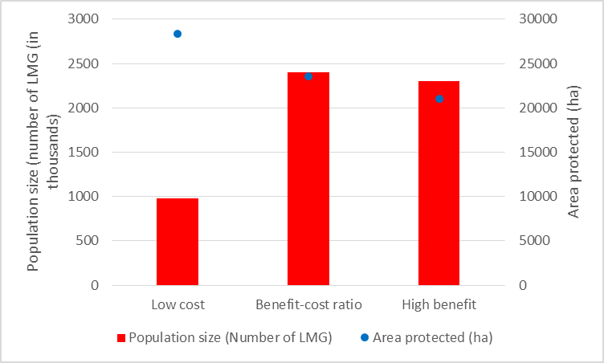
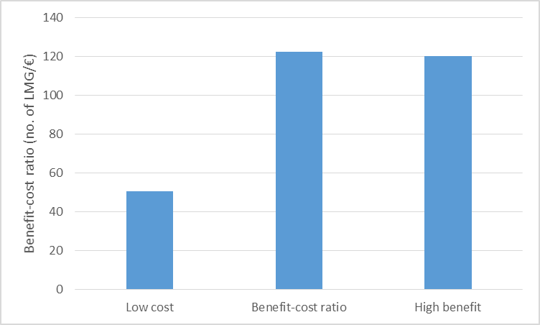
Conservation outcomes of different measures
Conserving the LMG with the conservation measure “very early mowing“ according to the strategies “low cost“, “high benefit“ and “benefit-cost ratio“ leads to the following outcomes:

Slide 16
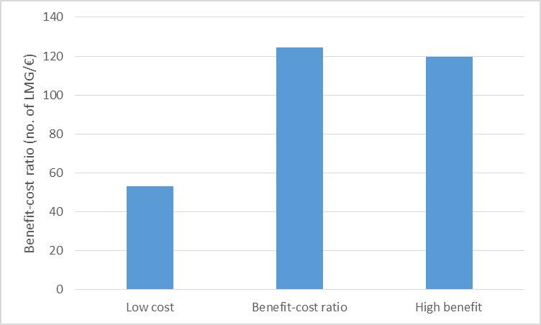
Conservation outcomes of different measures
Conserving the LMG with the conservation measure “early mowing“ according to the strategies “low cost“, “high benefit“ and “benefit-cost ratio“ leads to the following outcomes:

Slide 17
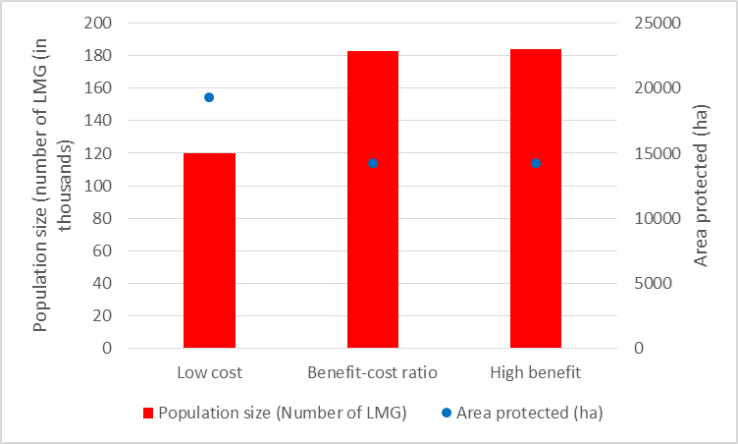
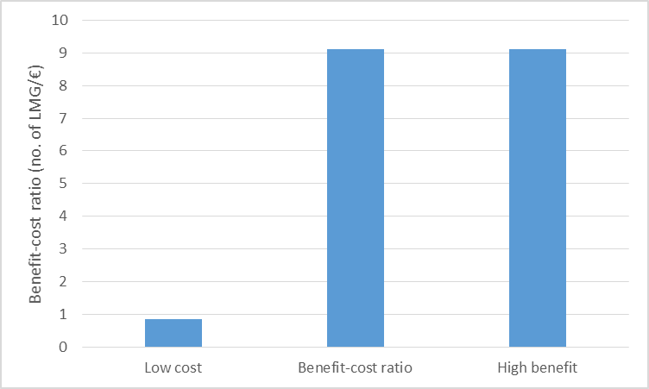
Conservation outcomes of different measures
Conserving the LMG with the conservation measure “late mowing“ according to the strategies “low cost“, “high benefit“ and “benefit-cost ratio“ leads to the following outcomes:

Slide 18
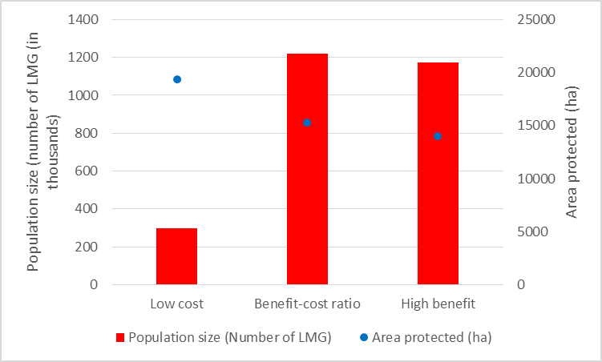
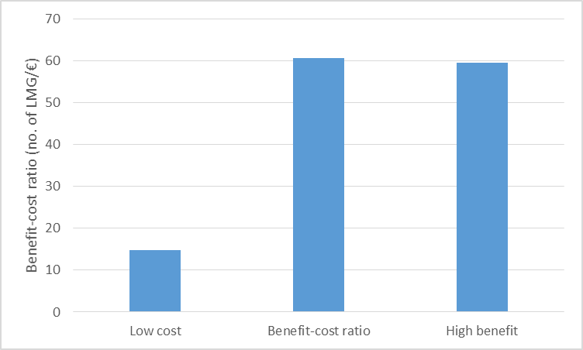
Conservation outcomes of different measures
Conserving the LMG with the conservation measure “very late mowing“ according to the strategies “low cost“, “high benefit“ and “benefit-cost ratio“ leads to the following outcomes:

Slide 19
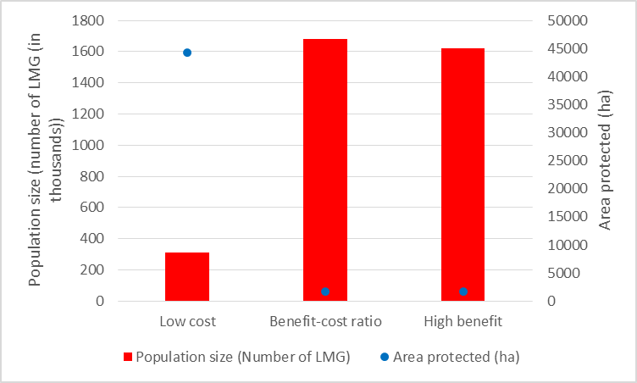
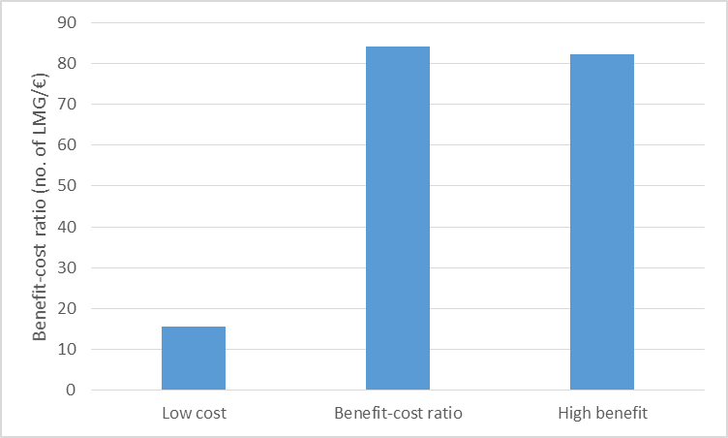
Conservation outcomes of different measures
Conserving the LMG with the conservation measure “mowing twice“ according to the strategies “low cost“, “high benefit“ and “benefit-cost ratio“ leads to the following outcomes:

Slide 20
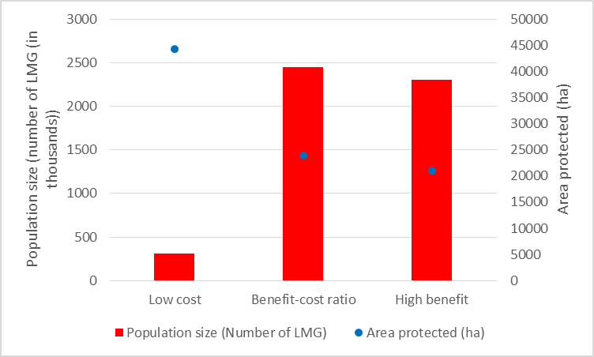
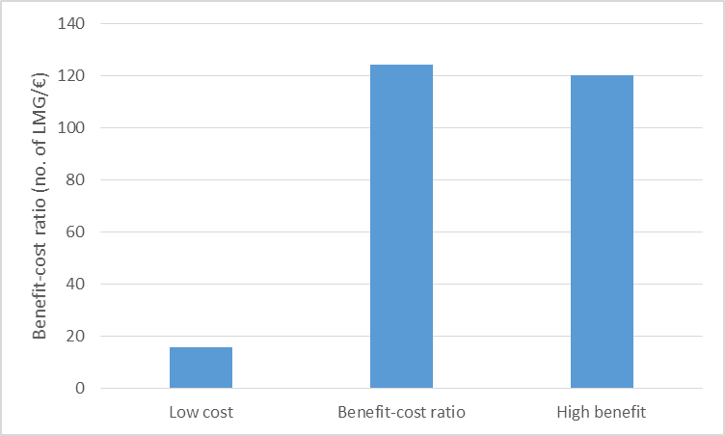
Conservation outcomes of different measures
Conserving the LMG with any conservation measure according to the strategies “low cost“, “high benefit“ and “benefit-cost ratio“ leads to the following outcomes:

Slide 21
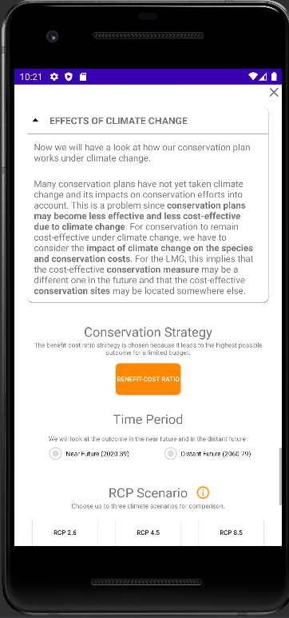
Effects of climate change – additional results
The following slides provide additional results not shown in the app
What if a different conservation measure was selected?

Slide 22
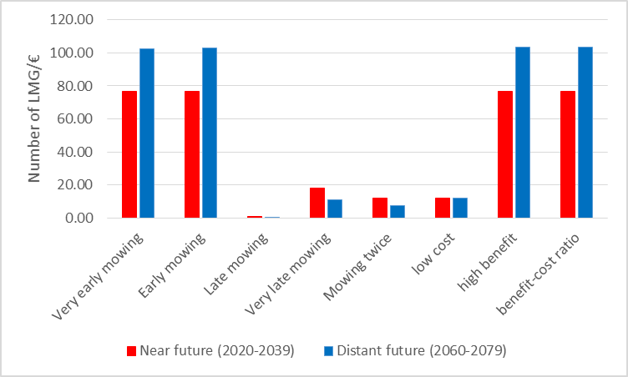
Effects of climate change – additional results
RCP2.6: Choosing individual conservation measures or according to the strategies “low cost“, “high benefit“ and “benefit-cost ratio“ leads to the following outcomes:

Slide 23
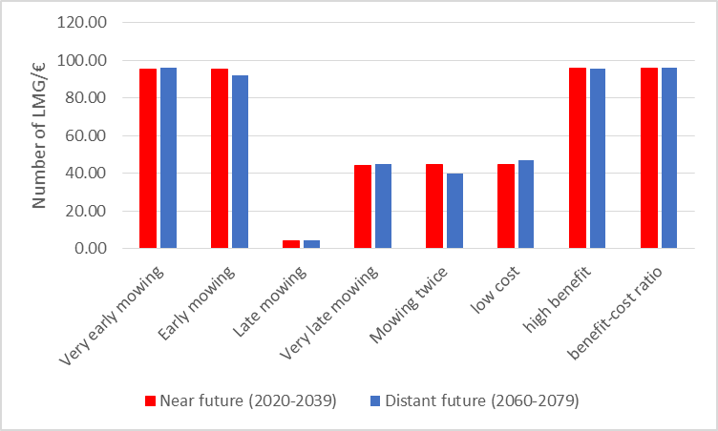
Effects of climate change – additional results
RCP4.5: Choosing individual conservation measures or according to the strategies “low cost“, “high benefit“ and “benefit-cost ratio“ leads to the following outcomes:

Slide 24
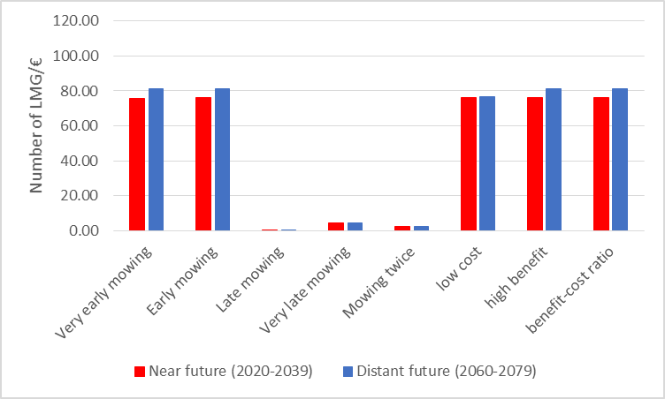
Effects of climate change – additional results
RCP8.5: Choosing individual conservation measures or according to the strategies “low cost“, “high benefit“ and “benefit-cost ratio“ leads to the following outcomes:

